Slide 1
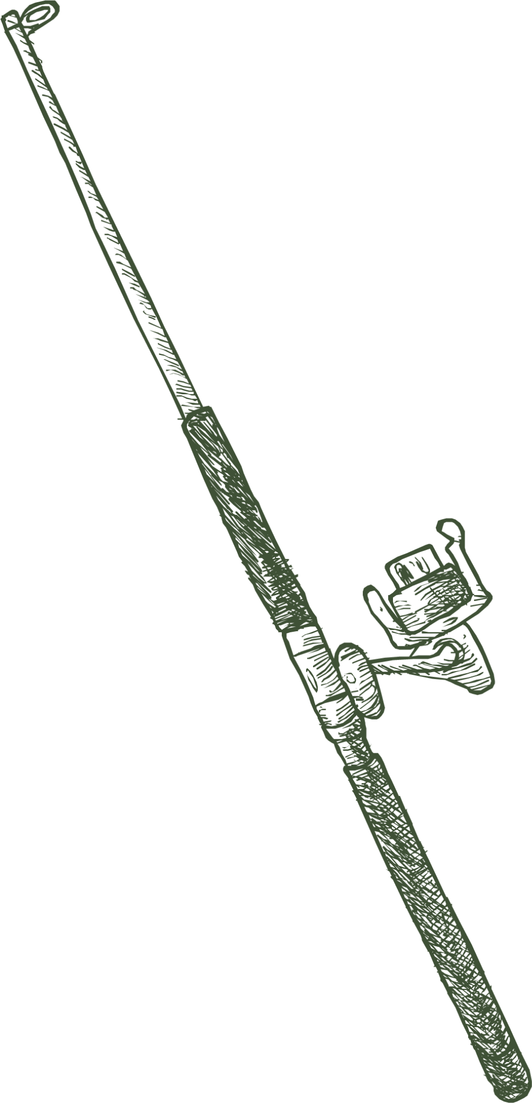
2023 Policy
Year in Review
Michigan United Conservation Clubs

Slide 2
Commercial Guiding
Senate Bills 103, 104, and 105
Sponsored by Senators Cherry, Daley, and McCann
Legislation had near universal support from the conservation stakeholder groups.
Bipartisan package was signed by Gov. Whitmer over Thanksgiving.

Slide 3
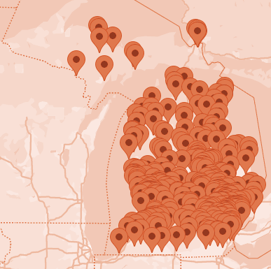
Commercial
Fishing
HB 5108
Opposed HB 5108, would allow for the commercial take of gamefish
MUCC released Call to Action in mid-October
Over 2500 individuals from all over the state took action
Sent over 86,000 emails to legislators
MUCC working on legislation consistent with our policy with Rep. O’Neal

Slide 4
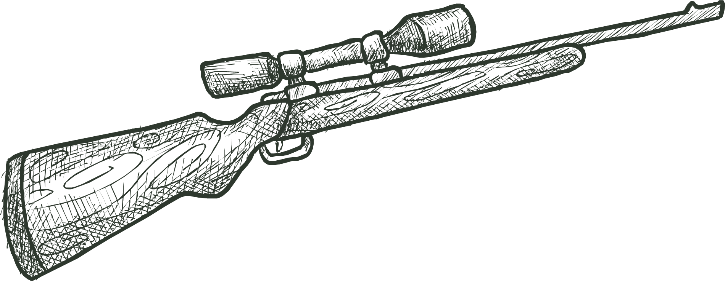
Gun Control
Gun Control
MUCC was very active in response to proposed gun control legislation earlier this session.
Supported Senate Bills 81 and 82, sales tax exemption for gun safety devices.

Slide 5
Solar Siting Recommendations
MUCC took a neutral stance on a large legislative package that outlined siting and zoning for solar and storage facilities.
MUCC did make recommendations consistent with our policies on siting.
Many of our recommendations regarding habitat, native grasses, pollinators, and migration concerns were included in the legislation that passed.

Slide 6
Hunters Safety in
Schools
SB 664, sponsored by Sen. Bumstead is supported by the DNR and Dept. of Education, and has bipartisan support.
Would create an optional model program that school districts can choose to adopt.
HB 5334 Sponsored by Rep. Vanderwall is the house companion with 54 co-sponsors.

Slide 7
Natural Resources
commission
No substantial changes to deer regs. NRC committing to deer work groups.
NRC adopted MUCC supported pike regulations on certain bodies of water.
Opposed
Nyberg Amendment
Wolf “decision tree” unveiled at the October meeting.

Slide 8
Other Items of Importance
Harvest Reporting
Unlawful Dumping
of Trash
Decriminalized failure to report. The pin feature has also been removed.
Supported legislation to increase penalties for illegal trash dumping.
Mentored License for Special Needs
DNR Budget
Secured funding for Brandon Road Lock and Dam, among other conservation priorities.
We have provided input on draft bills, but some complications remain. Hoping for early 2024 introduction.

Slide 9
L king Ahead to 2024
Commercial Fishing HB 5108 and MUCC’s version
Special Needs Mentored Hunting Legislation
Hunter’s Safety in School, SB 664 and HB 5334
MSAH & Cormorant Funding
NRC Deer Workgroup
Year round coyote hunting

